Slide 1



Wanna Play a Game?

Slide 2

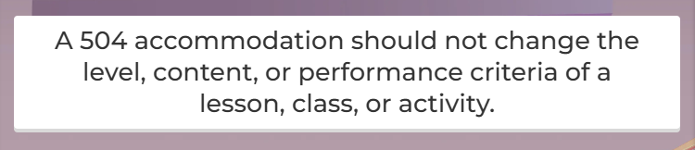
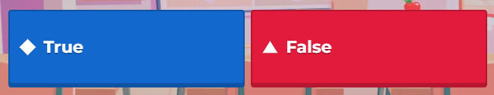
POINTS OF INTEREST | Accommodations
504 accommodations should also not change the reliability and validity of any assignment (OSPI)

Slide 3

POINTS OF INTEREST | Plans of Support
A student may have multiple disabilities that would qualify for both, but an IEP is written to include the accommodations that would otherwise be covered in a 504 plan.

Slide 4
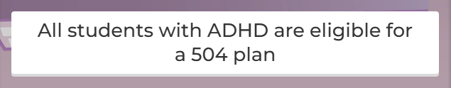
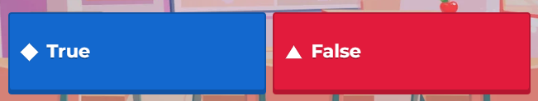
POINTS OF INTEREST | Eligibility
Remember, students who are entitled to a 504 plan (1) have a physical or mental impairment which substantially limits one or more major life activities, and (2) need accommodations, aids, or services—because of their disability—so they can access and benefit from their education.
Since some students with ADHD will not meet the threshold of #1, #2, or both, not ALL will be eligible for a 504 plan.
Resource Guide on Students with ADHD

Slide 5
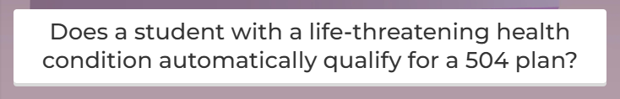
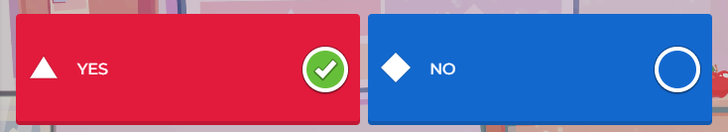
POINTS OF INTEREST | Eligibility
By definition, a student with a “life threatening health condition” has a physical or mental impairment that substantially limits a major life activity and qualifies as a disabled student under Section 504.

Slide 6
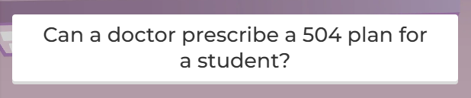
POINTS OF INTEREST | Roles & Responsibilities
The 504 team is responsible to gather and analyze data about the student’s condition to answer three questions:
Does the student have a physical or mental impairment?
If so, does the impairment substantially limit one or more major life activity?
If so, are there accommodations, aids, and/or services that the student needs in order to access an benefit from their education?

Slide 7
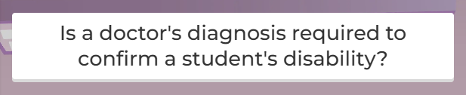
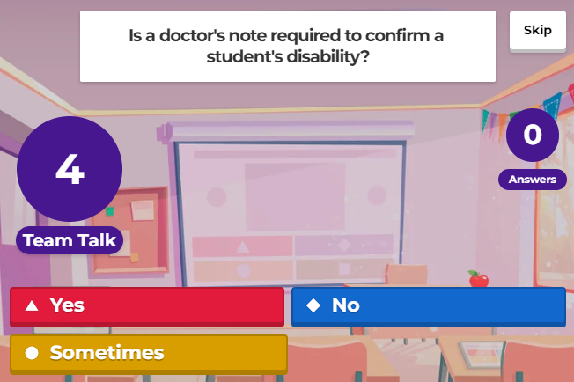

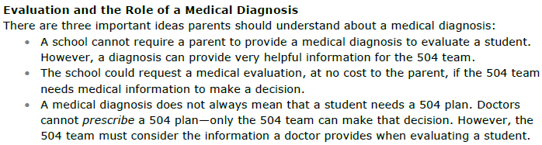
POINTS OF INTEREST | Medical Diagnosis

Slide 8

POINTS OF INTEREST | Medical Diagnosis

Slide 9
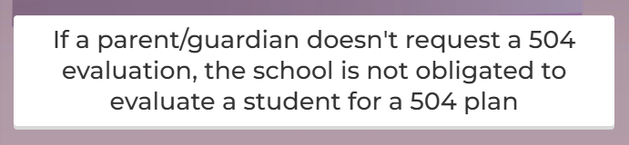
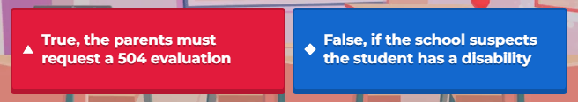
POINTS OF INTEREST | Responsibility to Refer
Anyone, including a parent or guardian, can refer a student for evaluation. Schools have a special responsibility to make a Section 504 referral for every student they know or suspect has a disability and may need accommodations, aids, or services.

Slide 10
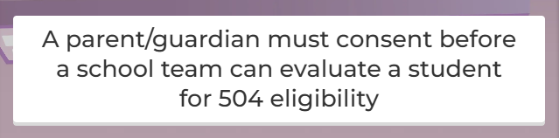
POINTS OF INTEREST | Consent to Evaluate
The school must have consent from a parent or guardian before the evaluation begins. Without consent, a 504 team cannot evaluate a student or continue the 504 process.

Slide 11
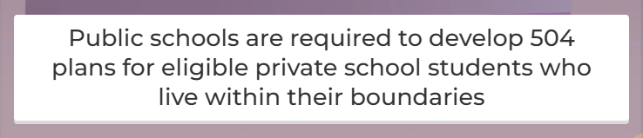
POINTS OF INTEREST | Private Schools

Slide 12
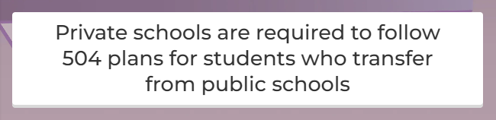
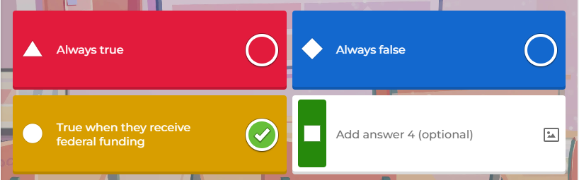
POINTS OF INTEREST | Private Schools

Slide 13
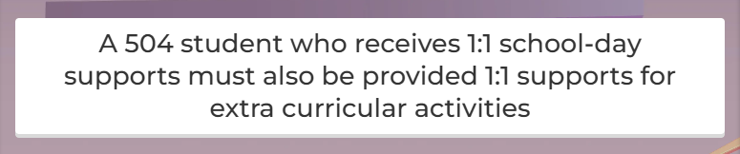
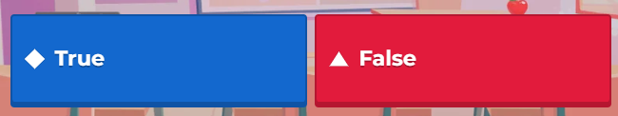
POINTS OF INTEREST | Extra-Curricular Supports
Public schools must provide appropriate accommodations, aids, and services to eligible students who need these accommodations to participate in, and benefit from, their education. This includes all programs and activities sponsored by the school, such as sports and field trips.

Slide 14
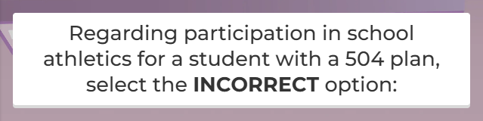
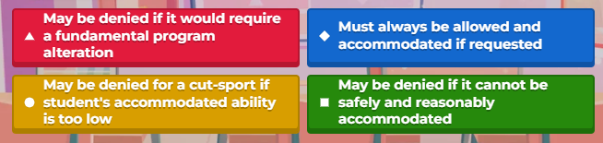
POINTS OF INTEREST | Extra-Curricular Supports
School districts can require a level of skill or ability for a student to participate in sports, so long as the selection criteria are not discriminatory. That said, students with disabilities should be allowed to try out similarly to their non-disabled peers.

Slide 15
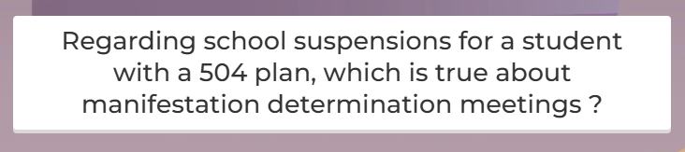
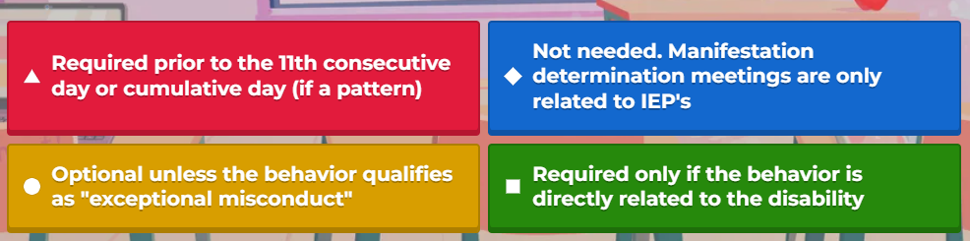
POINTS OF INTEREST | Manifestation Determinations
Note: This is one of the purposes of the manifestation meeting (which is why it wasn’t the correct answer)

Slide 16
POINTS OF INTEREST | Manifestation Determinations
Use form 504-10 for manifestation determinations
Long-Term Removals
If the student is being removed 10 or more consecutive days, the school must conduct a manifestation determination.
Short-Term Removals
If the student is removed less than 10 total school days in a school year, no manifestation is required.
If the student is removed for 10 or more total school days in a school year, a manifestation determination may be required. For short-term removals, the school must conduct a manifestation determination when there is a “pattern of exclusion,” considering the length of each removal, the total days removed, and the proximity of removals to one another.

Slide 17
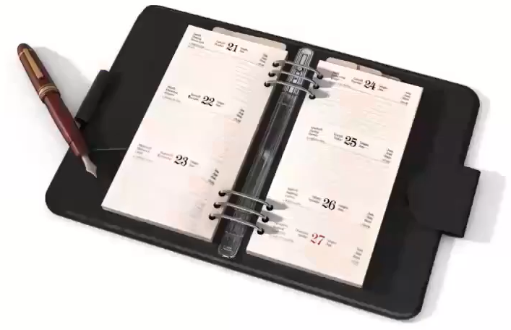
POINTS OF INTEREST | Manifestation Determinations
OSPI NOTE:
When conducting a manifestation determination, a Section 504 team must consider:
Was the conduct caused by, or did it have a direct and substantial relationship to, the child’s disability?
Was the conduct the direct result of the school’s failure to implement the Section 504 plan?
If the answer to either question is yes, the school cannot remove the student for the behavior. Rather, consider revisiting the Section 504 plan and conducting a re-evaluation.

Slide 18
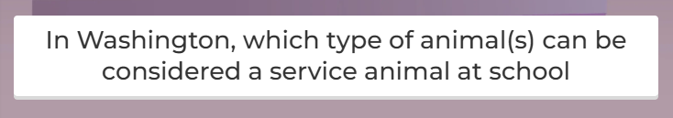
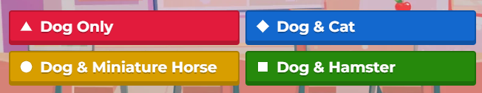
POINTS OF INTEREST | Service Animals

Slide 19
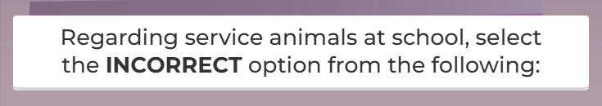
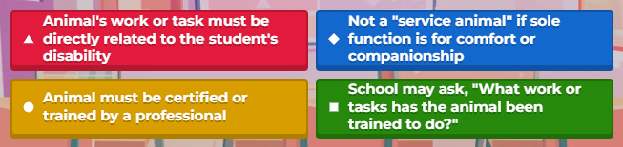
POINTS OF INTEREST | Service Animals

Slide 20
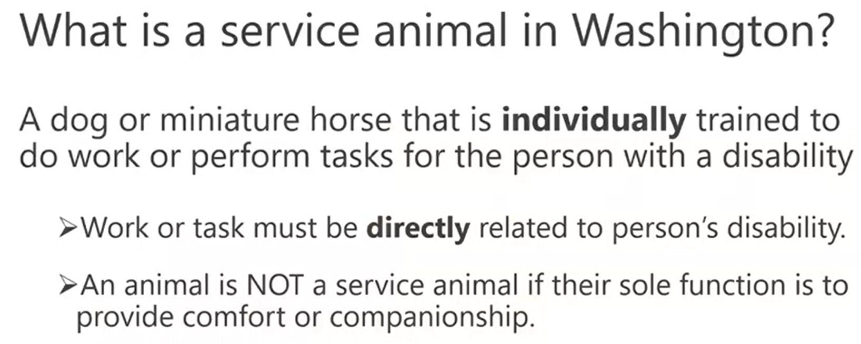
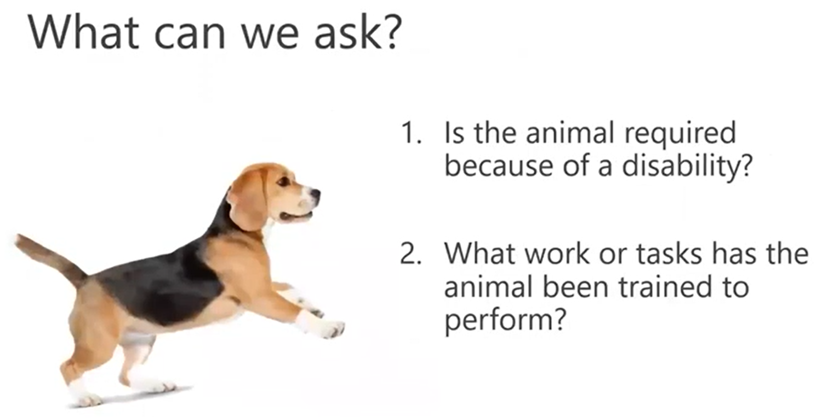
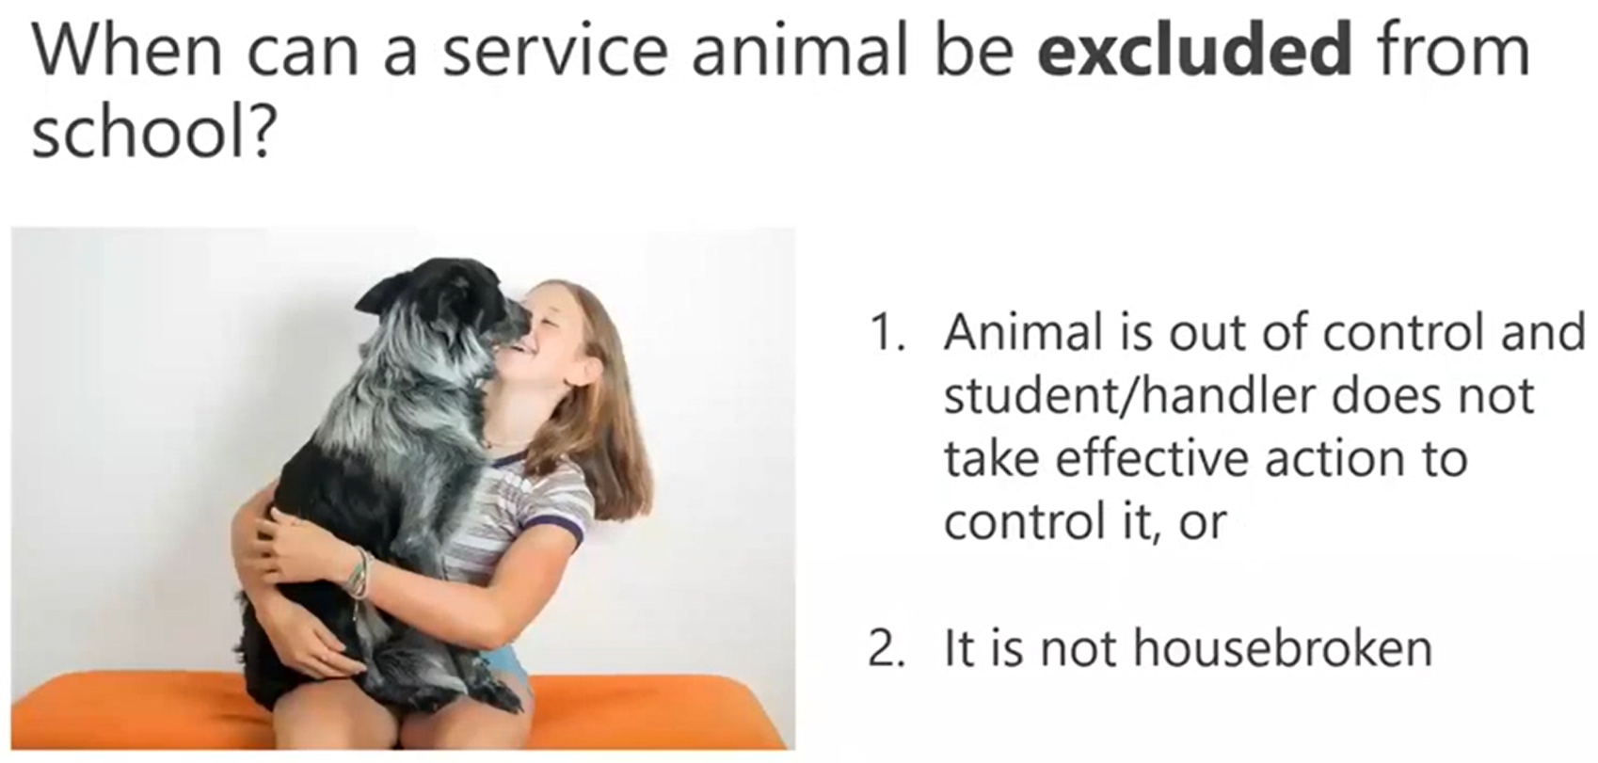
POINTS OF INTEREST | Service Animals
Click here for helpful EPS resources:
Service Animal Requirement Checklist | 2030P

Slide 21
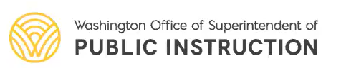
ADDITIONAL RESOURCES
Navigating Section 504 Webinar | Slide Deck Handout
Section 504: Beyond the Basics Webinar | Slide Deck Handout
OSPI’s Section 504 Resources for School Districts
OSPI’s Section 504 Resources for Families

